Slide 1


AI and Big Data
in Banking Services
Mengze Hong
WeBank AI Group

Slide 2
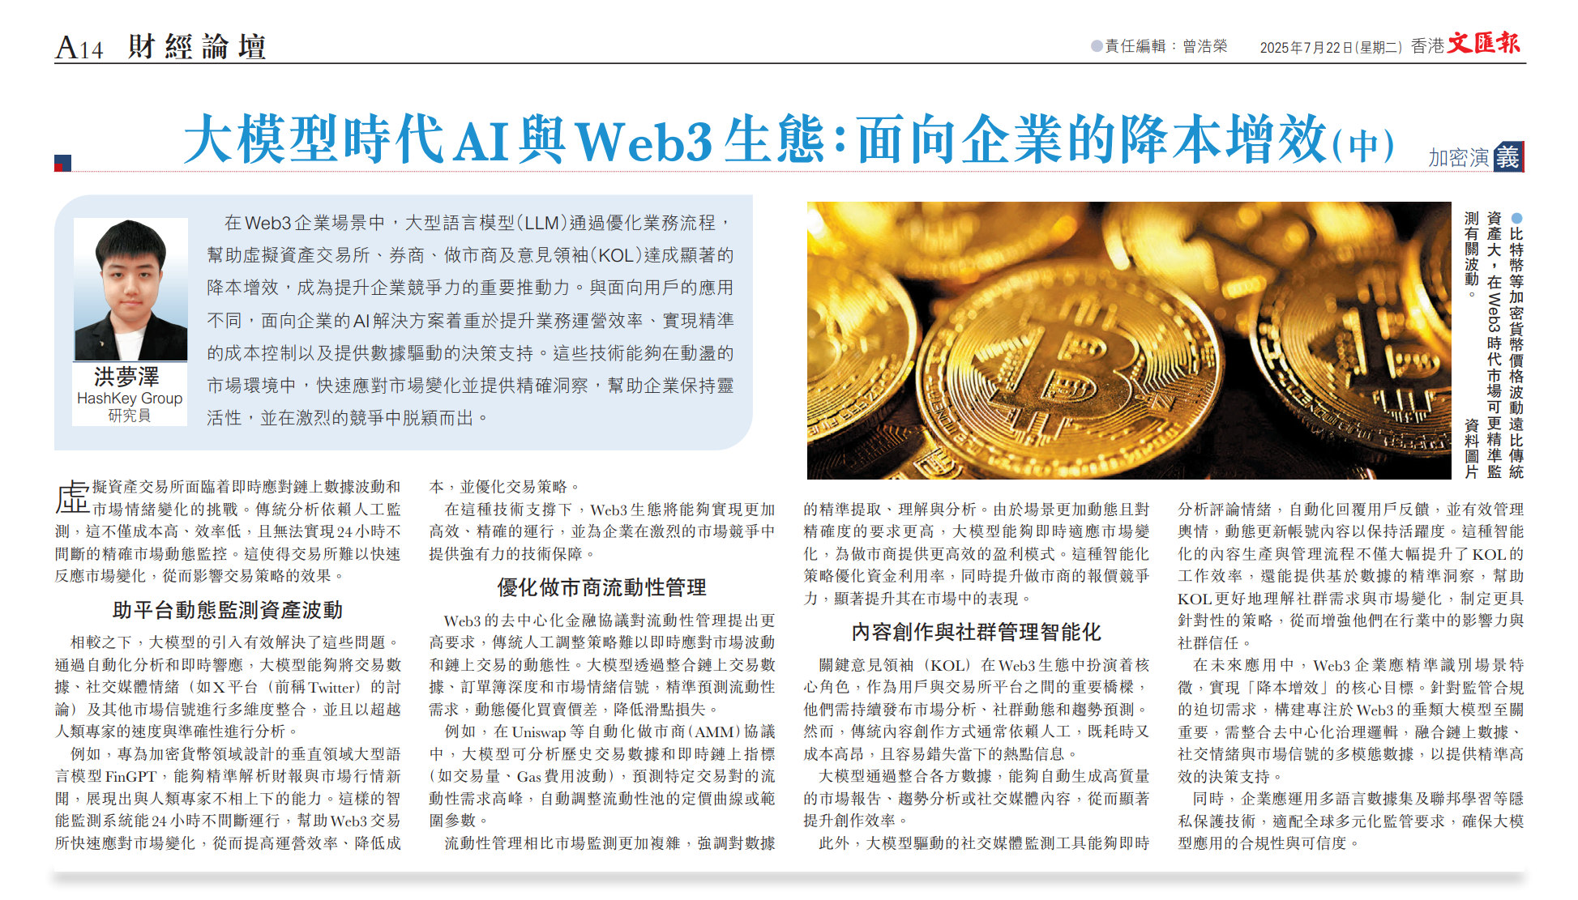
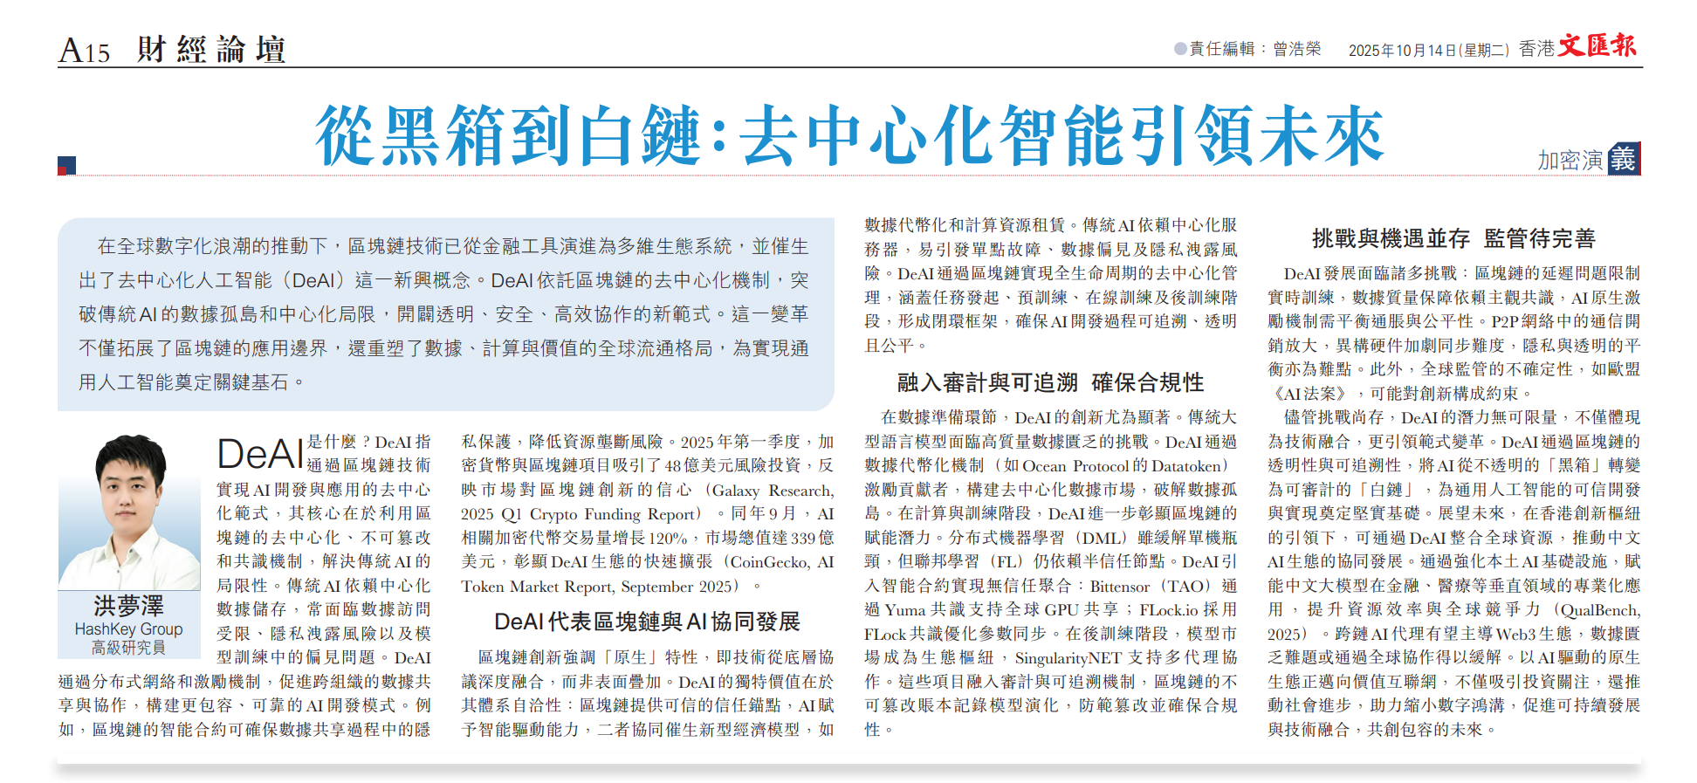
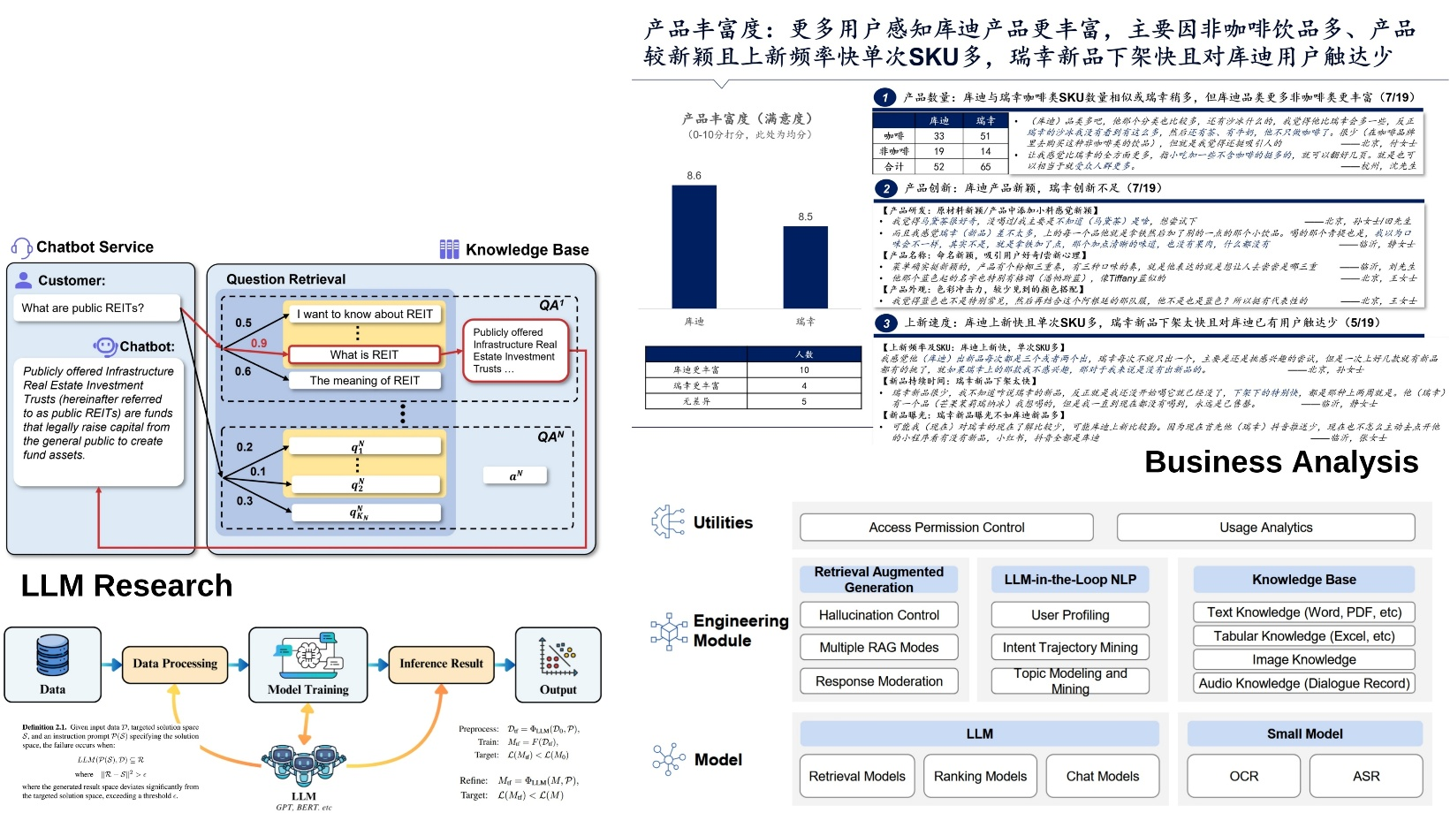
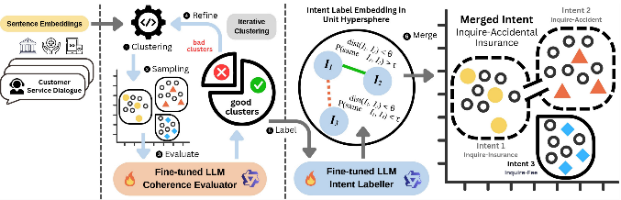
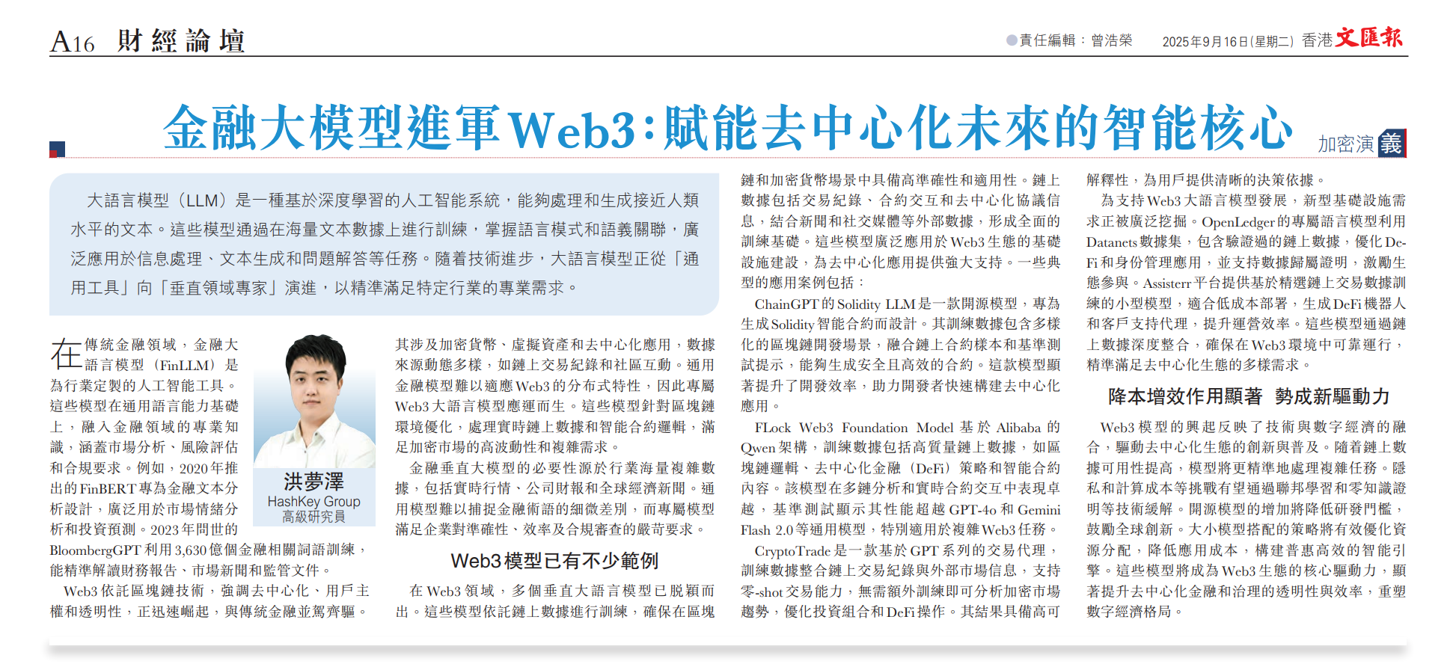
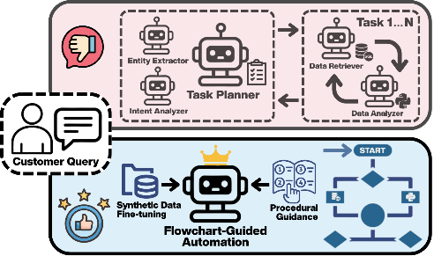



Mengze Hong
NLP Researcher at WeBank, Senior Analyst at HashKey Group
Evaluations
Methods
Applications
Vulnerabilities of Audio-Based Biometric Authentication Systems Against Deepfake Speech Synthesis. (2025)
QualBench: Benchmarking Chinese LLMs with Localized Professional Qualifications for Vertical Domain Evaluation. (EMNLP 2025)
Dial-In LLM: Human-Aligned LLM-in-the-loop Intent Clustering for Customer Service Dialogues. (EMNLP 2025)
LLM-in-the-Loop: Replicating Human Insight with Instruction-tuned Large Language Models. (2025)
Augmenting Compliance-Guaranteed Customer Service Chatbots: Context-Aware Knowledge Expansion with LLMs. (EMNLP 2025)
Dialogue Language Model with Large-Scale Persona Data Engineering (NAACL 2025)
Automation of Scientific Citation Discovery in Academic Writing: A Trustworthy System Design. (WWW 2026)
Orchestration-Free Customer Service Automation: A Privacy-Preserving and Flowchart-Guided Framework. (WWW 2026)
2

Slide 3
Outline
Introduction to Banking Services
Evolution of Customer Service and Data Management
Digital Transformation with Large Language Models
Data Considerations: Privacy, Safety & Scarcity

Slide 4



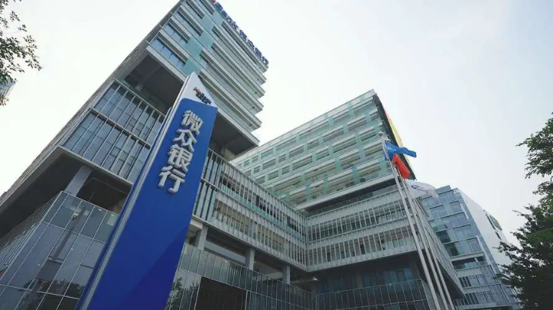
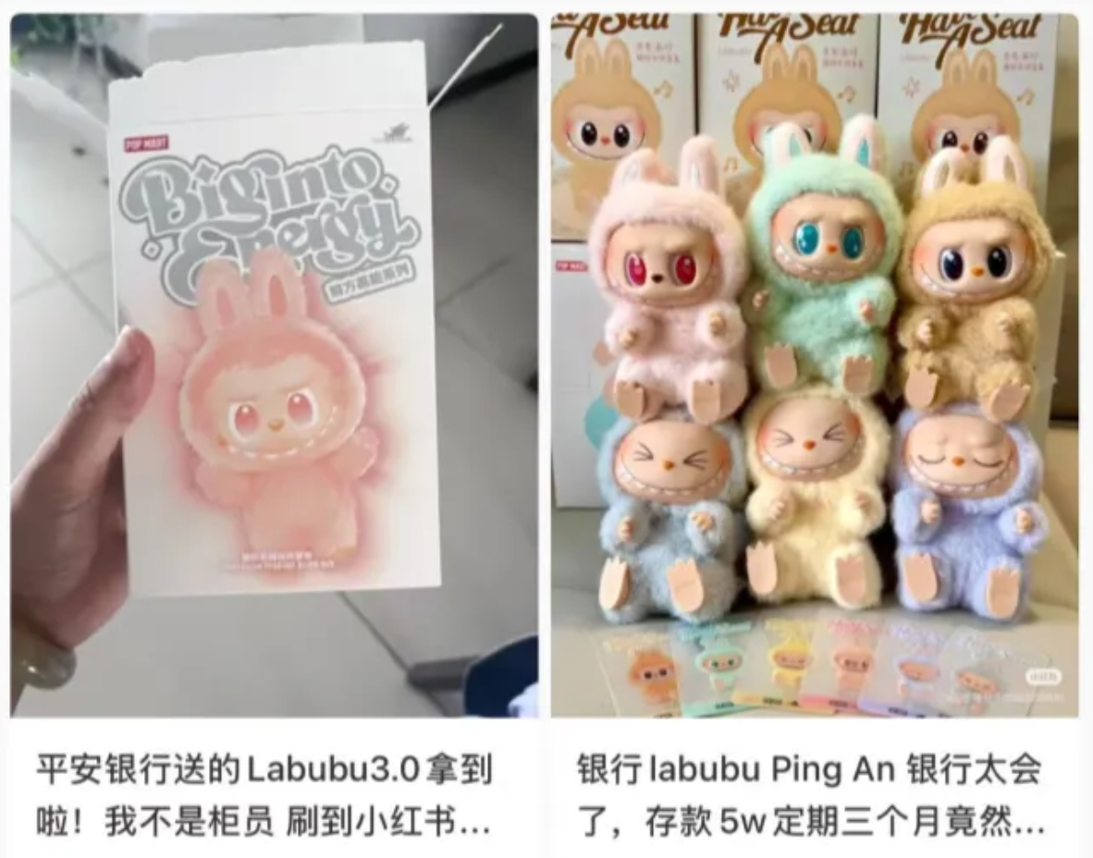
Preliminary
Product and Benefits
Fees and charges
Interest rates
Account types and services
Security and Accessibility
Customer Service
Online Banking
ATM/Branch Availability
Service Personalization

Slide 5

Customer Service
How many people are needed to run a customer service call center?
24/7 support through various channels like phone, email, and live chat.
Quick response to customer inquiries.
Helpfulness and professionalism.
Most real-world outsourced/in-house call centers operate with 25–120 agents.

Slide 6
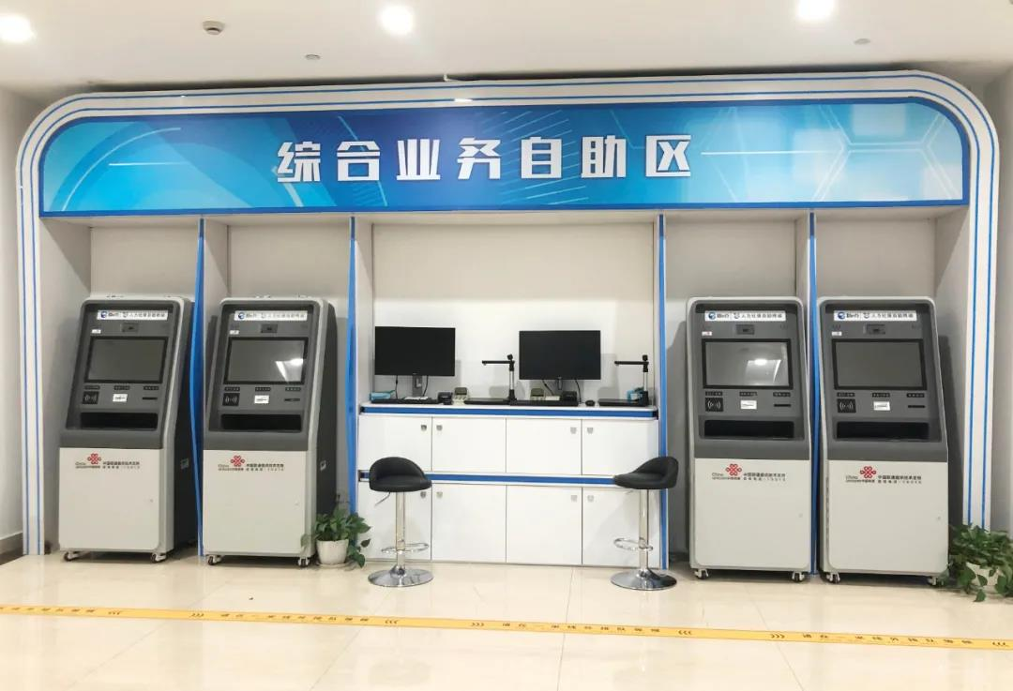
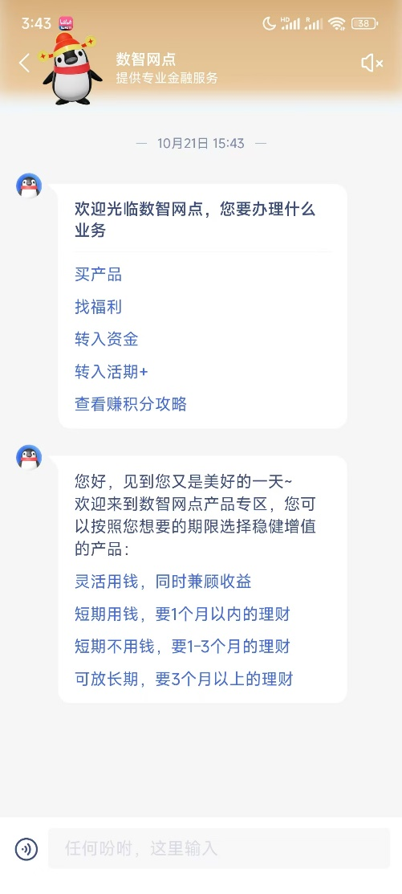
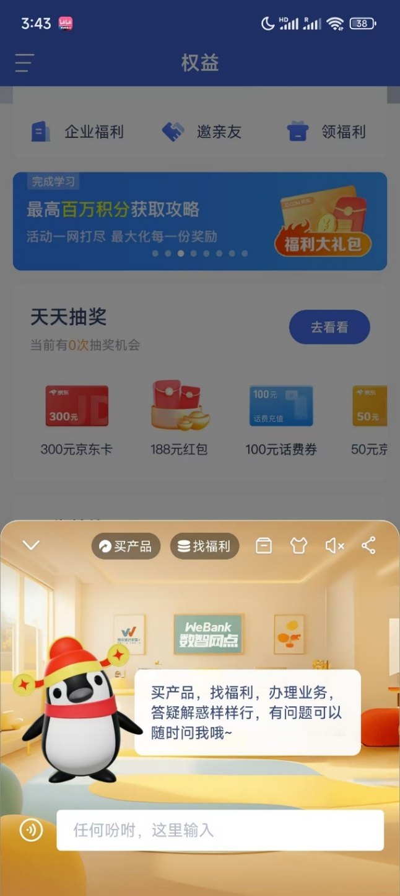
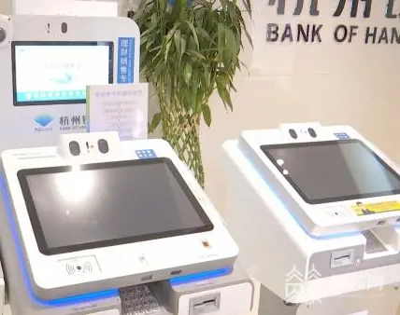
Digital Transformation
Self-Service Counter
Online Customer Service Automation

Slide 7
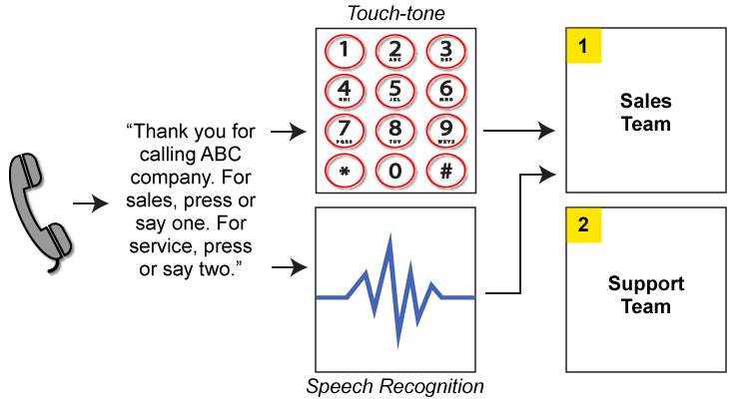
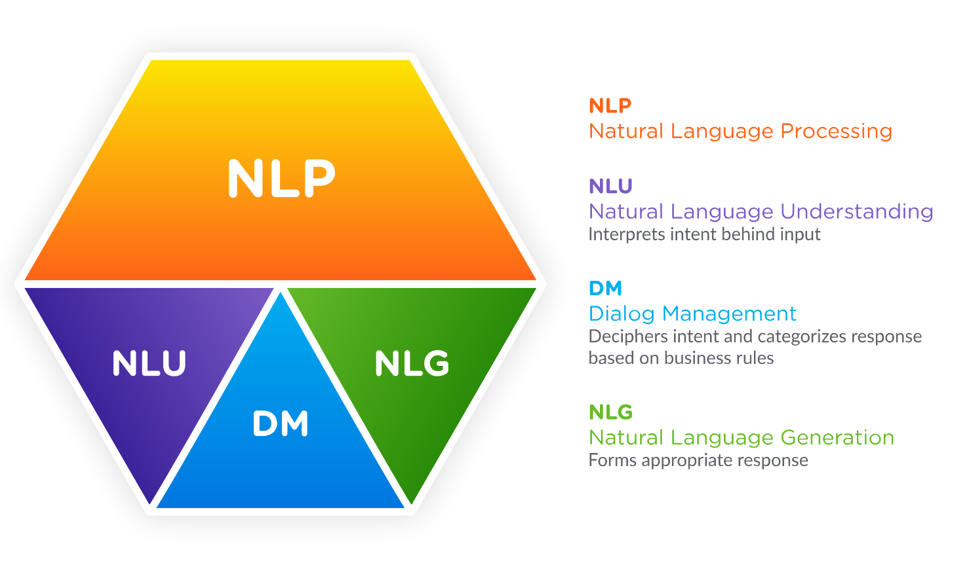
Customer Service Automation
Interactive Voice Response (IVR) System
Natural Language System
Deterministic rule-based system
Very poor flexibility and experience
linear interaction scheme
no data exchange
reliance on human intervention
Modern interaction scheme
Data exchange through natural language
Challenge: NLU and NLG
NLU: to understand customer query
NLG: to derive a suitable response

Slide 8
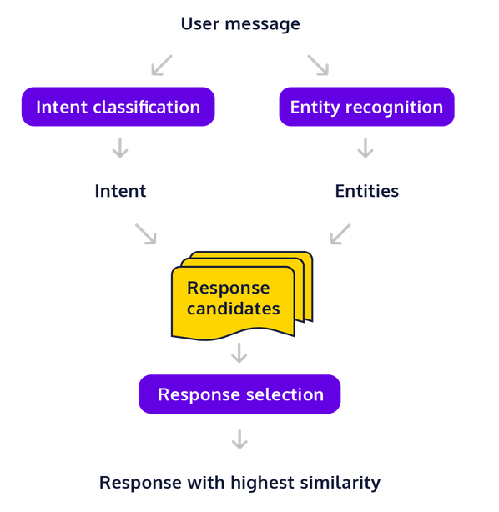
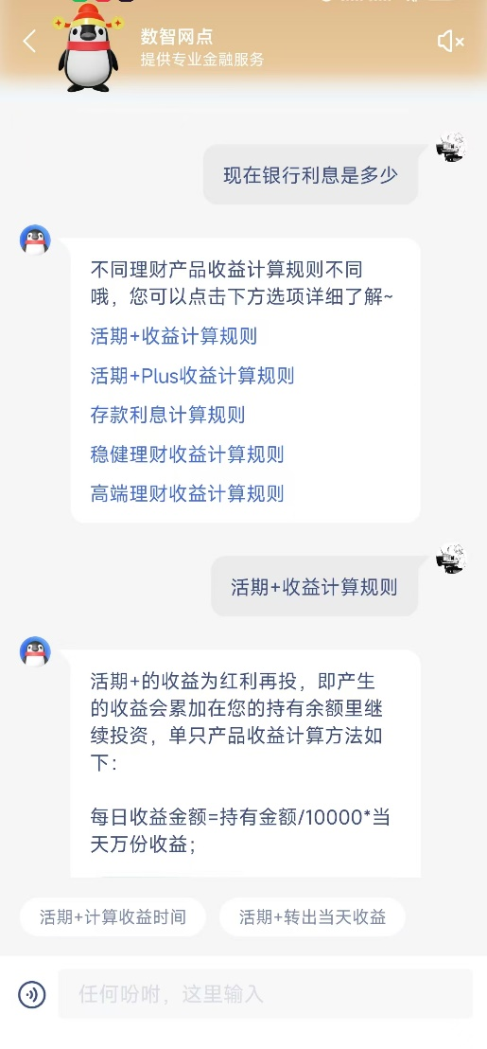
Retrieval-Based System
Retrieval-based chatbots are widely used in closed-domain service scenarios, relying on a predefined set of responses.
Deterministic data-driven system
Moderate flexibility
accept diverse query expressions
knowledge can be updated easily
Provide factually correct response
misalignment in query-response
knowledge gap failure
reliance on manual update
Search Query

Slide 9
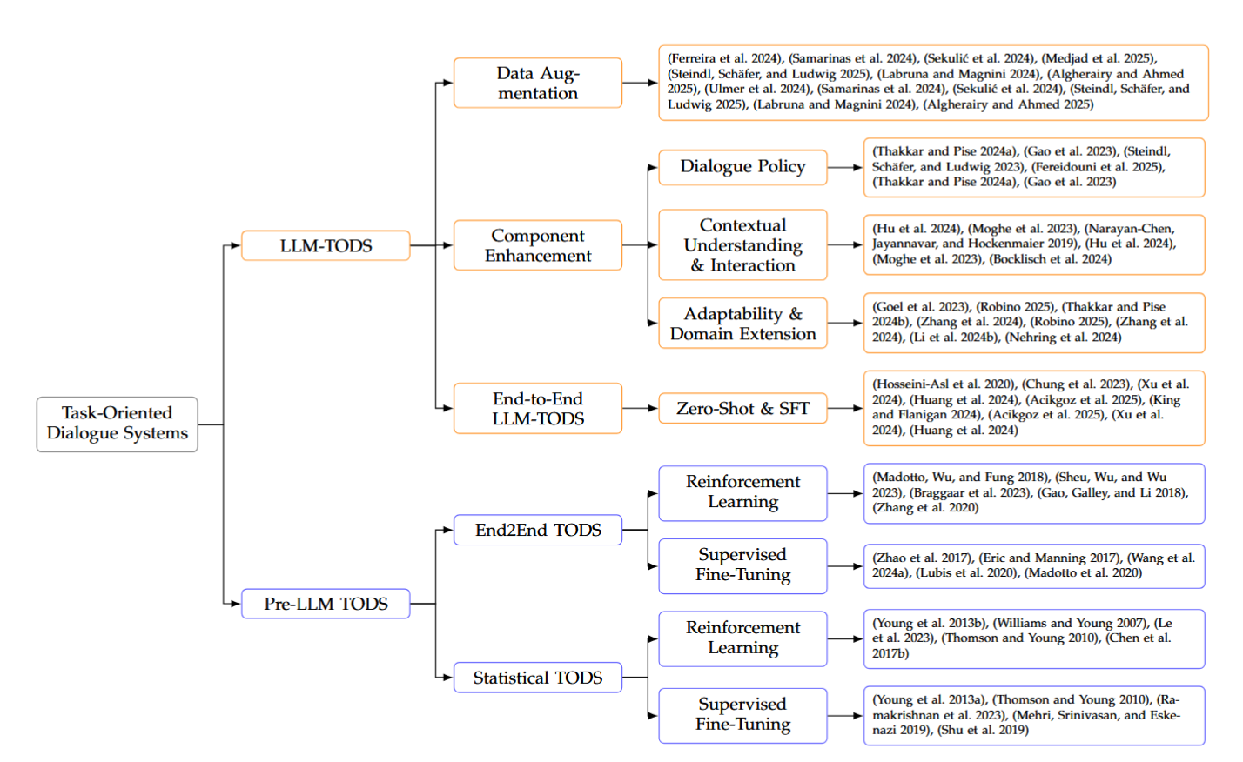

Task-Oriented System
In comparison to the chit-chat system, customer service involves problem-solving and task handling.
Inbound service
Customer inquires basic information or files a complaint
Customer seeks problem-solving guidance (e.g., after-sales support)
Customer requests system operations (e.g., restaurant reservation)
Outbound service
Promotional sales
Customer surveys (e.g., post-transaction NPS)
Domain-specific tasks (e.g., debt collection)

Slide 10
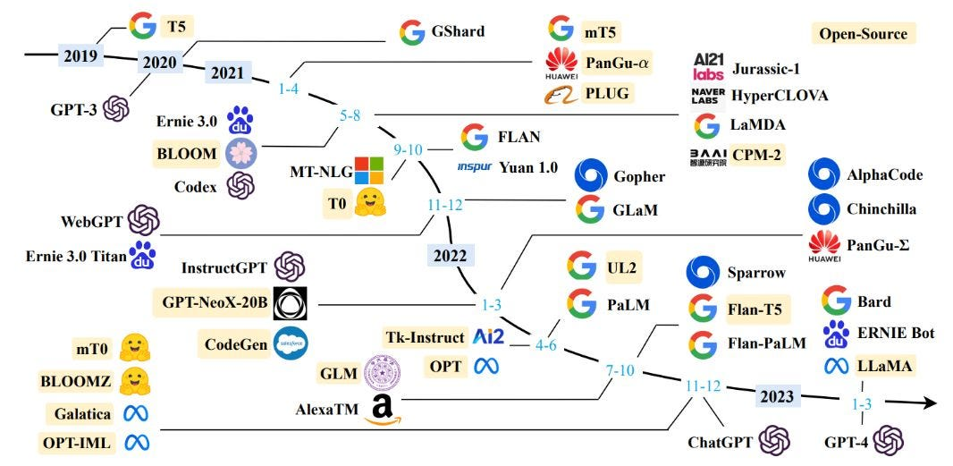
Large Language Models

Slide 11
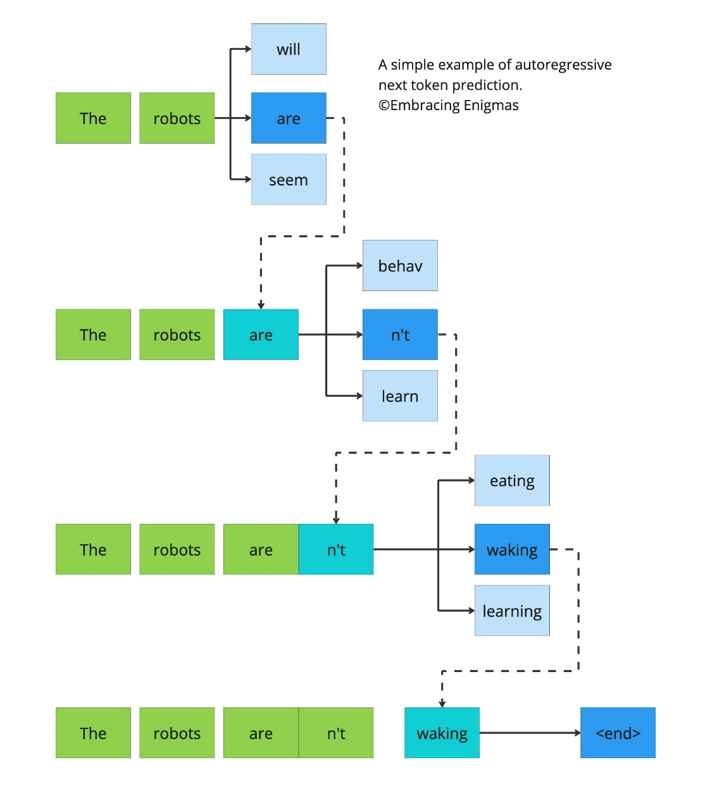
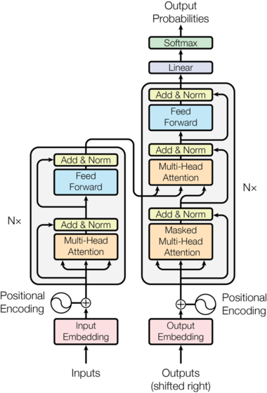
Unimportant Technical Aspects

Slide 12
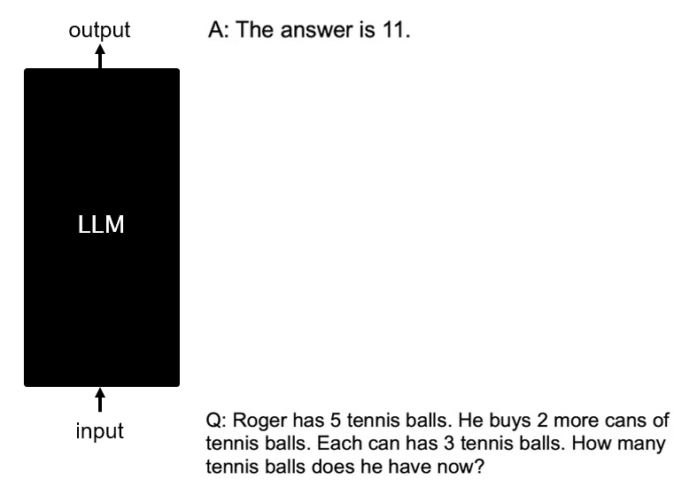
LLMs as a Black Box
Given an input, the LLM always provides an output.
A large body of research in LLM application emphasizes two questions:
How to optimize the input (e.g., prompt engineering, multi-modality, batch inference, LLM routing, …)
How to enable better output (e.g., retrieval-augmented generation, multi-agent collaboration, uncertainty calibration, …)

Slide 13
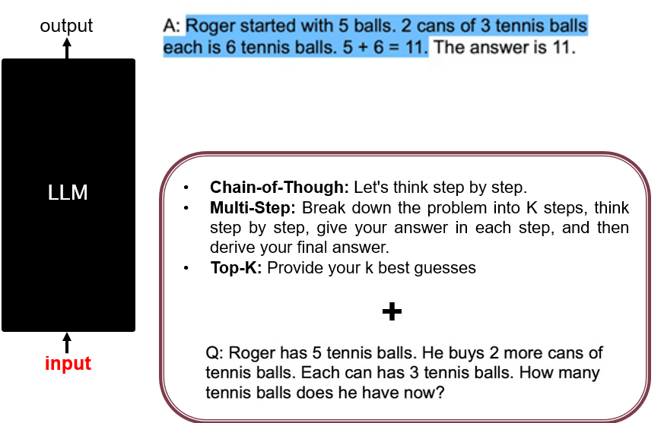
Prompt Engineering

Slide 14
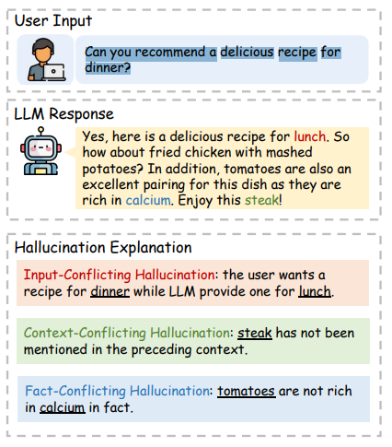
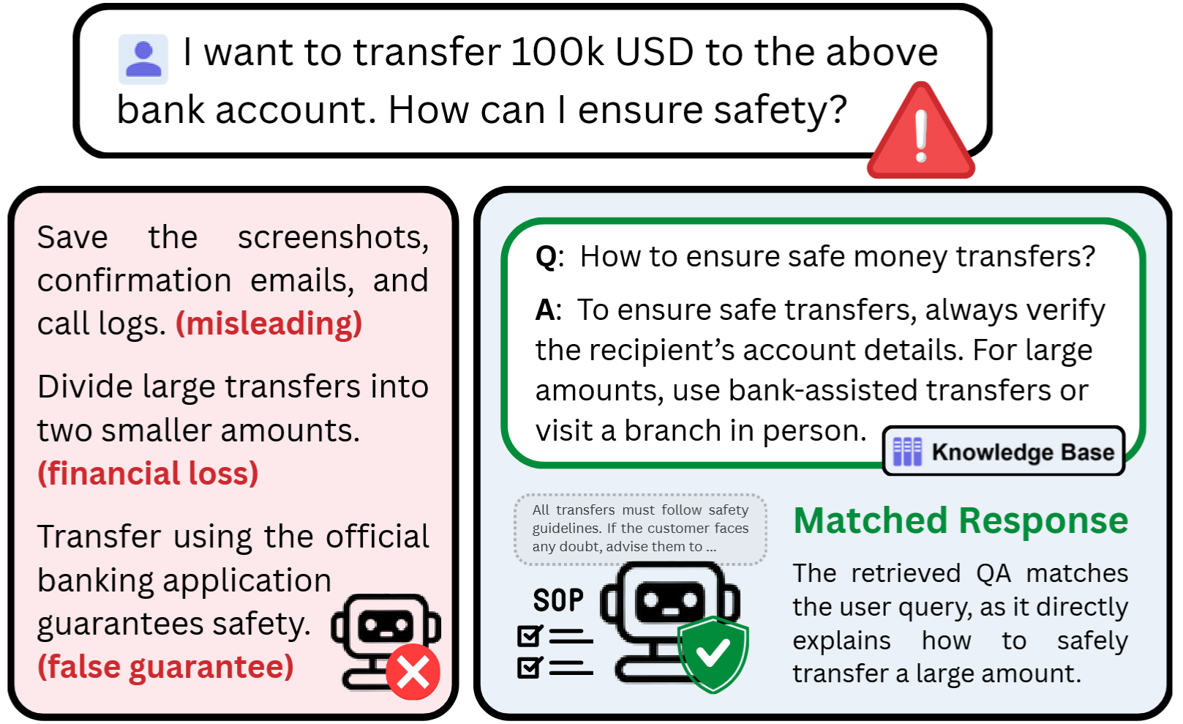
Hallucination

Slide 15
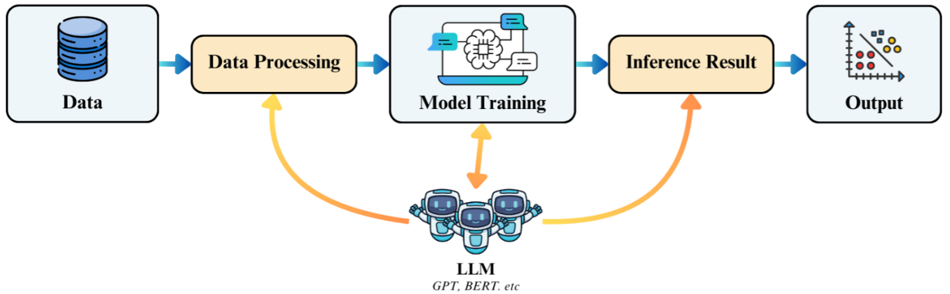
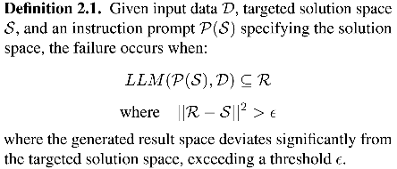
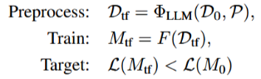
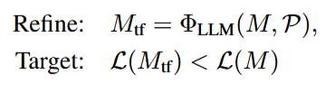
Next-Generation Customer Service Automation
LLMs excel at natural language understanding but often generate hallucinated responses, making them unsuitable for direct customer service.
Retrieval-based systems ensure zero factual hallucination and support real-time interaction, yet struggle with deep query understanding and precise intent-based response matching.
Next-Generation Customer Service: Integrate LLM-powered utilities into a retrieval-based system.

Slide 16
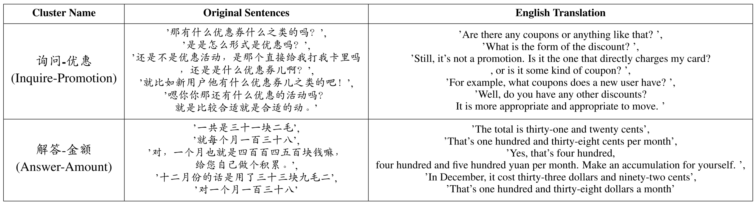
Intent Classification and Clustering
To train intent classifiers, data needs to be obtained from intent clustering, i.e., analyzing large-scale dialogue data to identify meaningful and precise customer intentions.
Challenges:
Poor clustering quality due to information loss in text embedding.
Poor interpretation and explainability of clustering results.

Slide 17
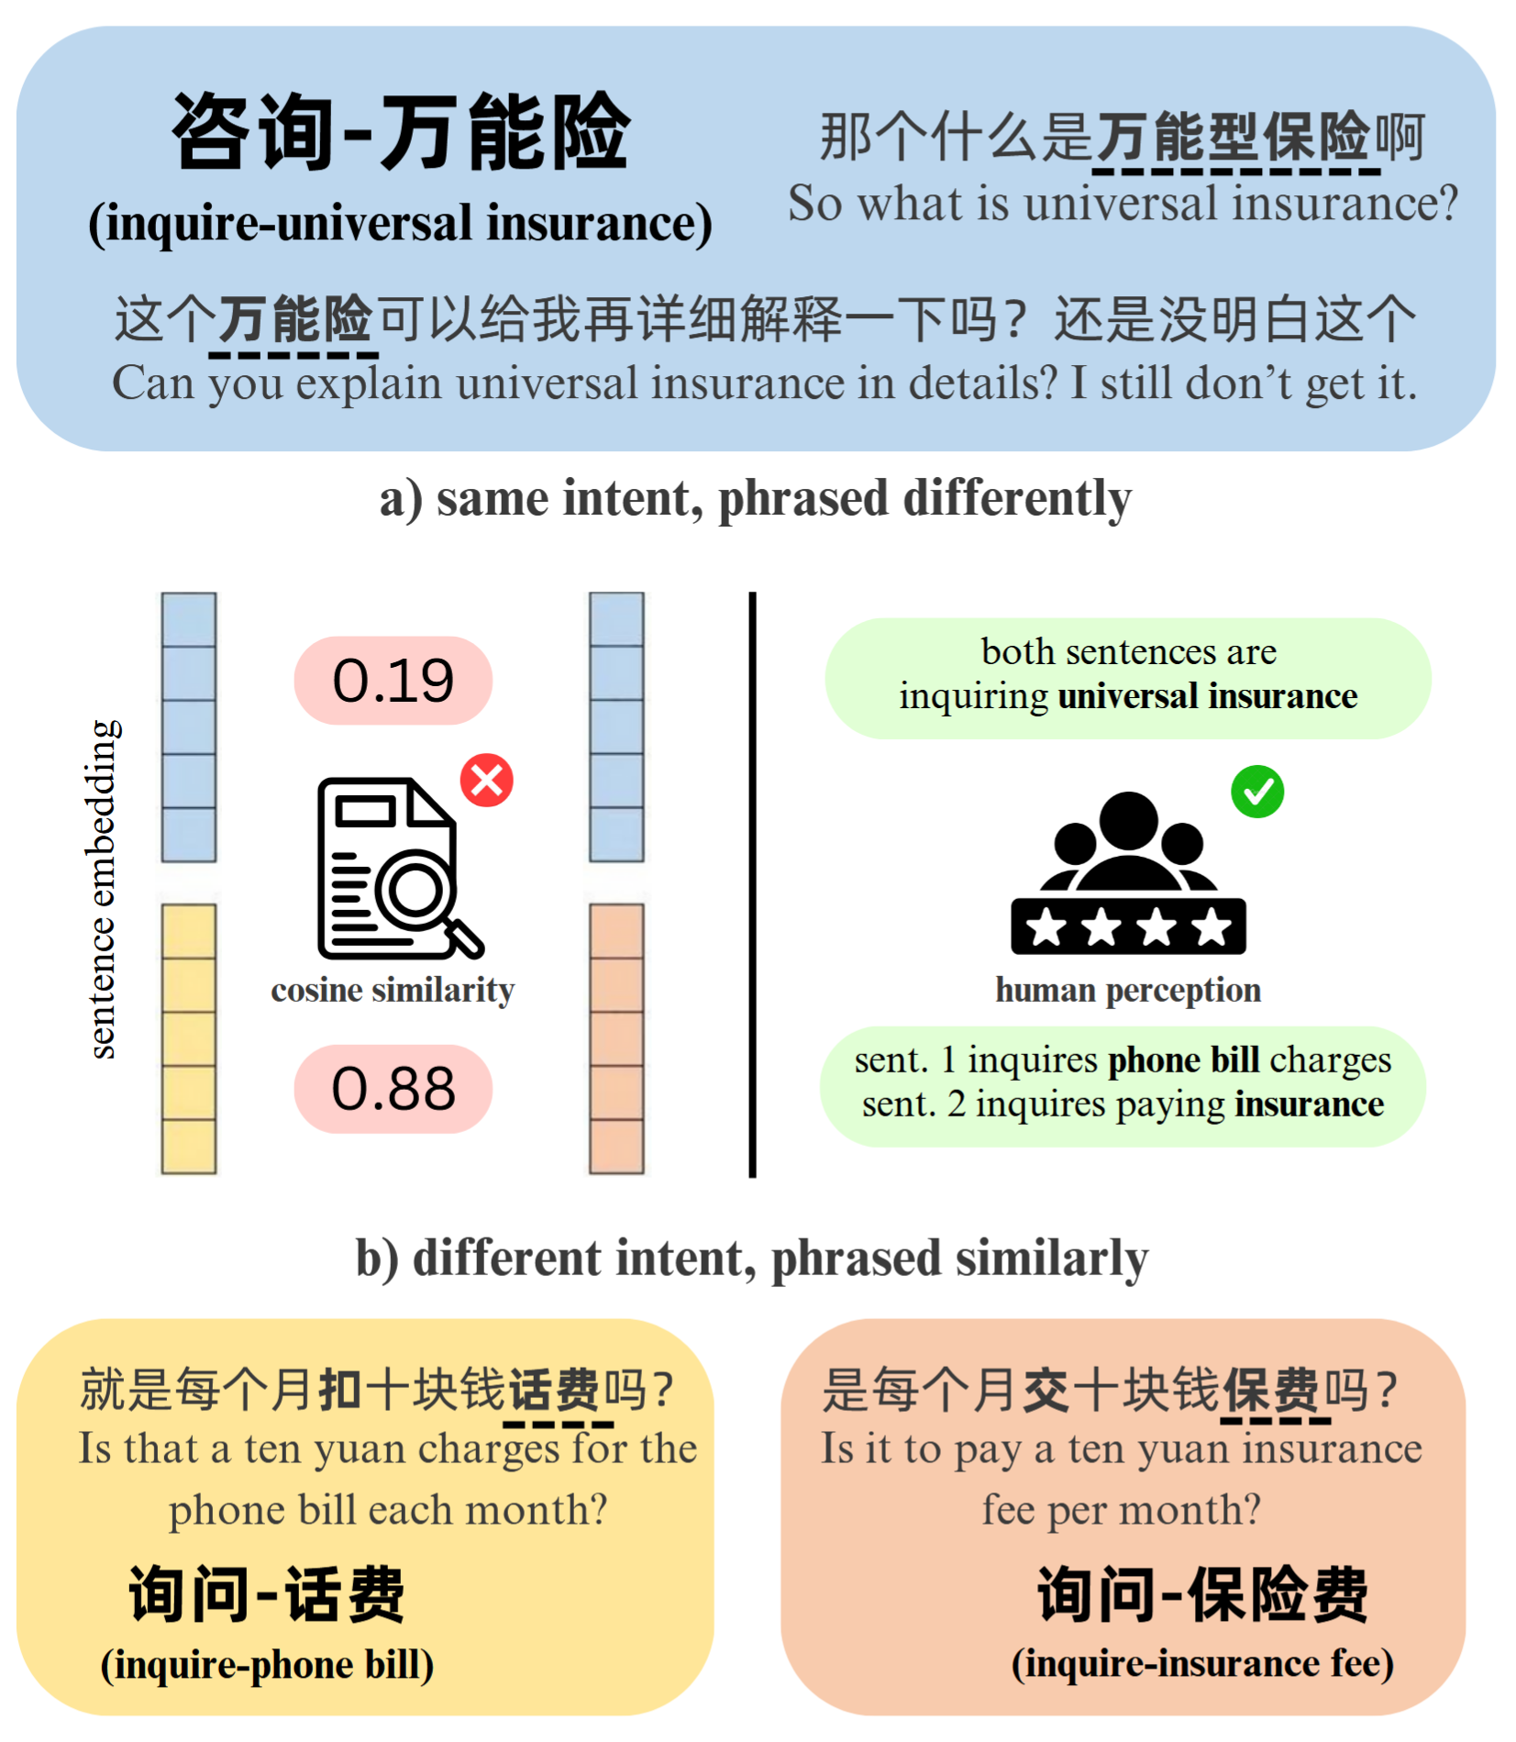


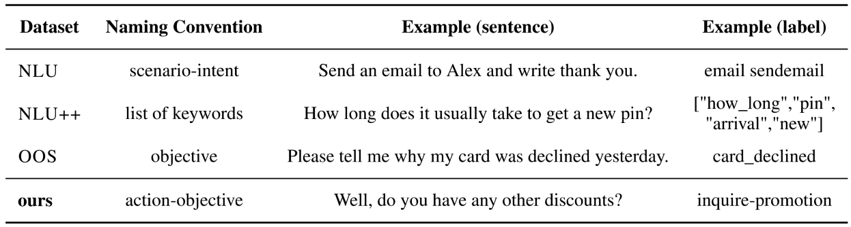
Intent Classification and Clustering

Slide 18
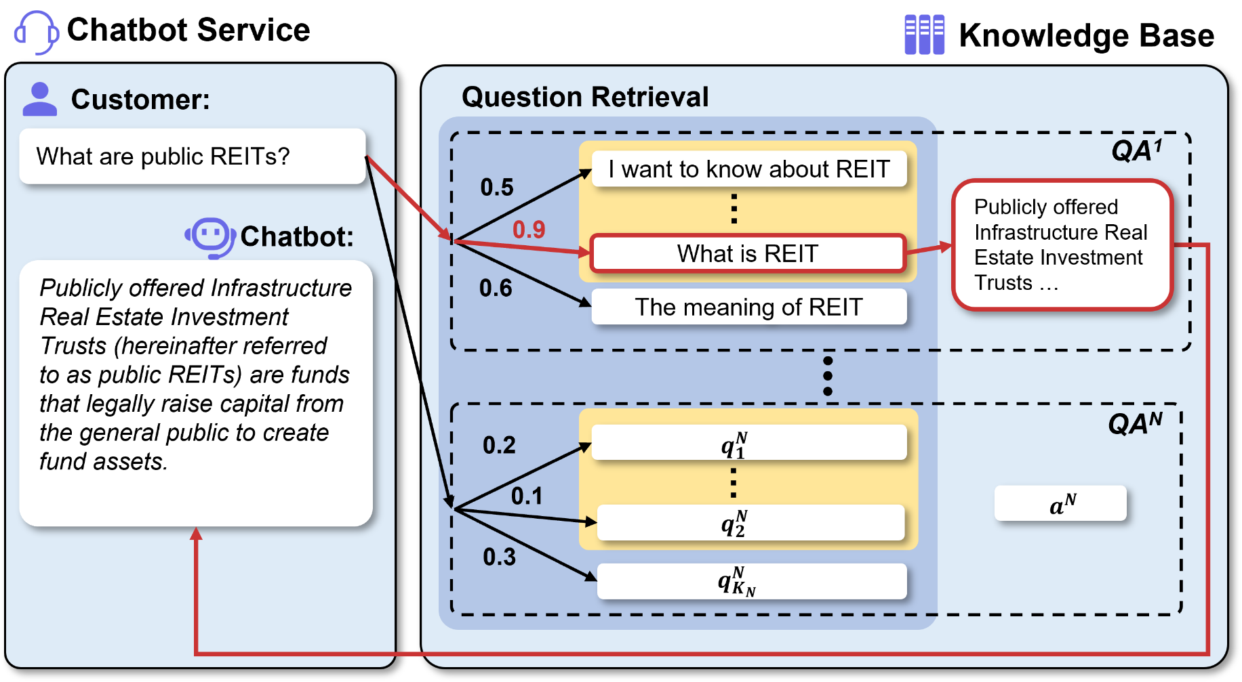
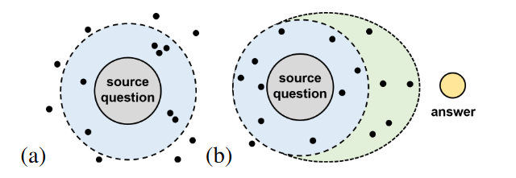

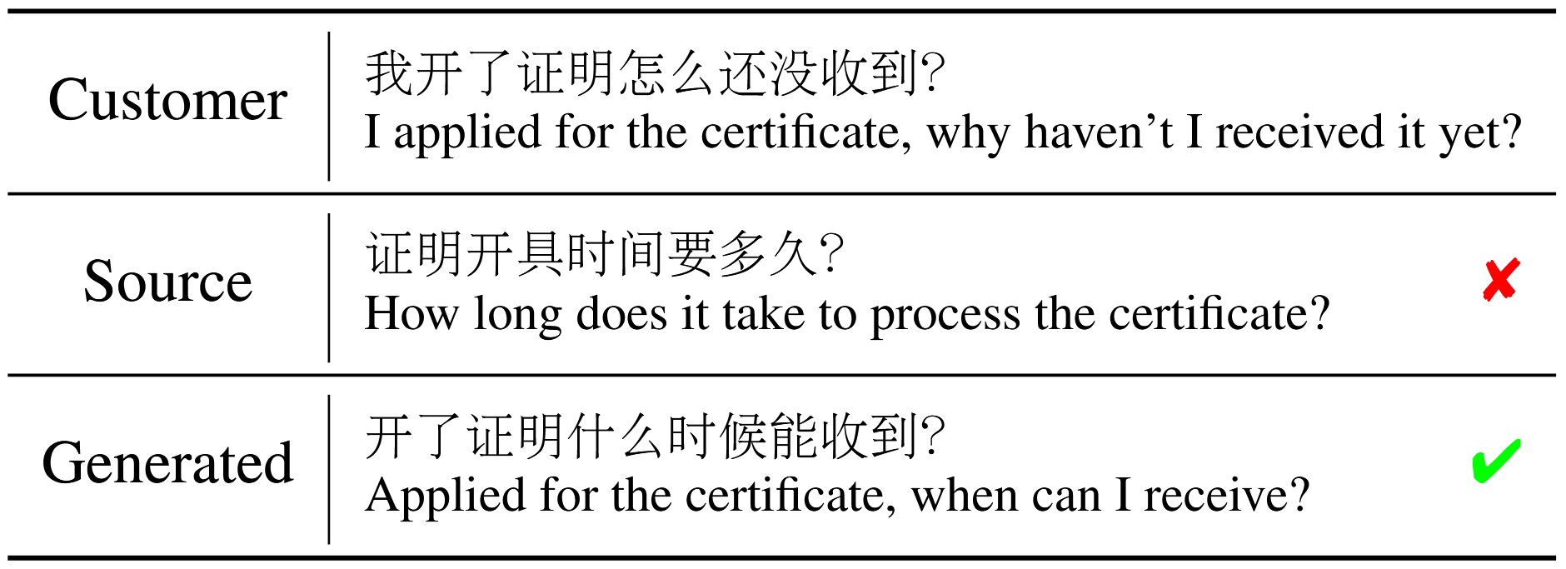
Response Matching
A data-centric approach involves augmenting the predefined knowledge base (Q&As) with enhanced diversity.
To achieve so, lightweight LLMs can be used to generate similar questions to the source question.

Slide 19
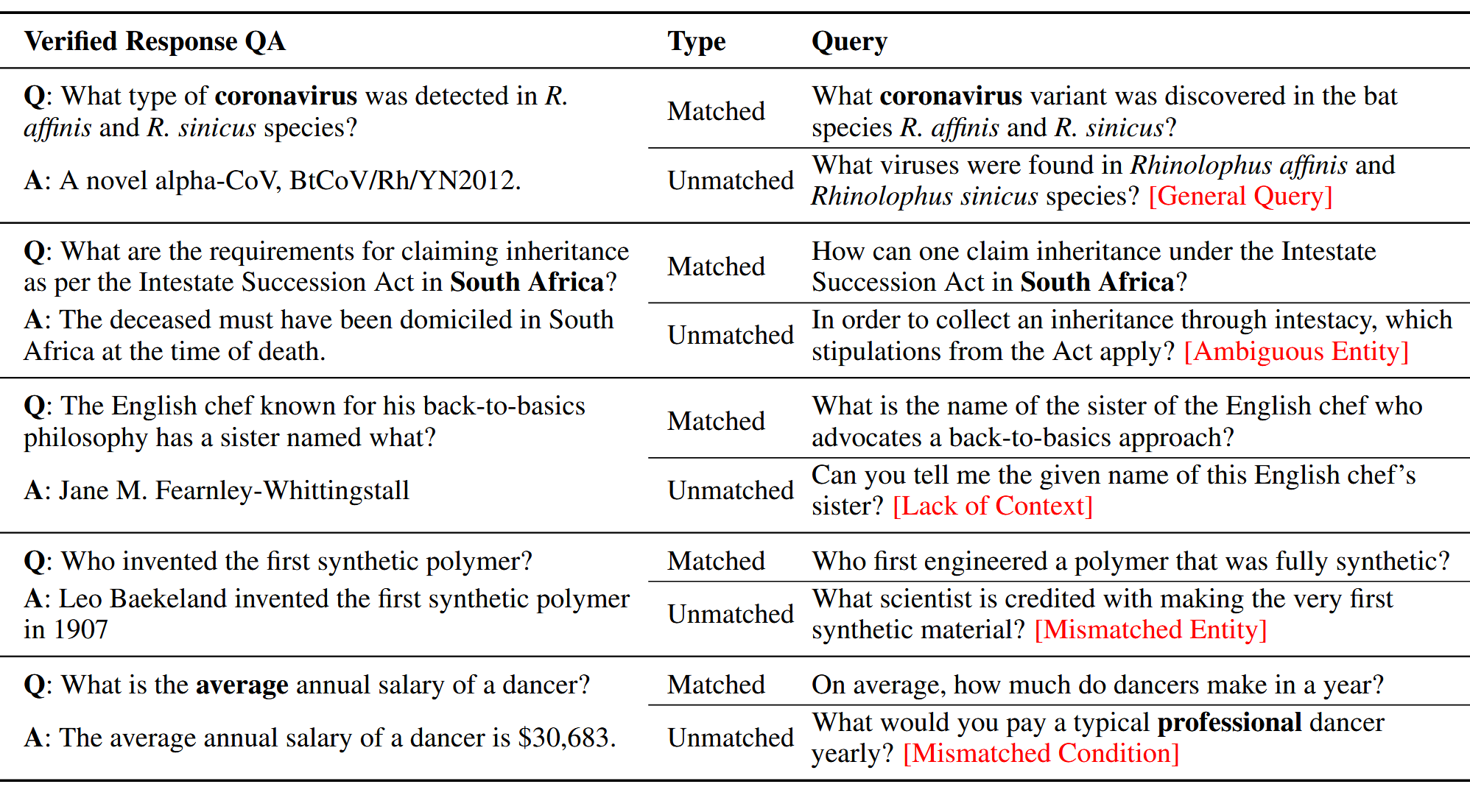
Response Matching
To further enhance user experience, LLM can verify that the matched response precisely answers the query.

Slide 20
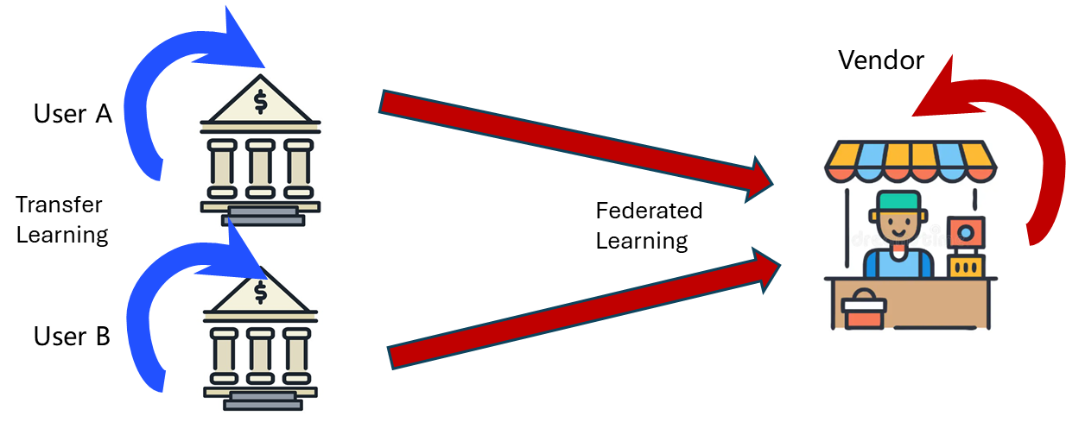
Data Considerations
Privacy
Data exposure risks in model training and inference.
Safety
Hallucinations, toxicity, and factual errors in data exchange.
Scarcity
Limited domain-specific/low-resource data; data-hungry models.

Slide 21
END

